Slide 1
Archana V
Final Project
3/21/2024 Annual Review

Slide 2
PROJECT TITLE
Language Identifier
3/21/2024 Annual Review

Slide 3


AGENDA
Problem Statement
Project Overview
Who are the end users?
Solutions and value of propositions
WOW factor in the solution
Modelling
Results
3/21/2024 Annual Review

Slide 4

PROBLEM STATEMENT
The problem statement of a Language Identifier typically involves developing a system or algorithm that can automatically detect and identify the language of a given text input. This task is essential for various natural language processing (NLP) applications, such as multilingual text processing, language-specific analysis, and language-based content filtering. The goal is to create a model or system capable of accurately determining the language of a text snippet, regardless of its length or complexity.
3/21/2024 Annual Review

Slide 5

PROJECT OVERVIEW
Project focuses on the development of a robust and efficient language identification system capable of accurately detecting the language(s) present in a given text input. In an increasingly interconnected world with vast amounts of multilingual content, the ability to automatically identify languages is essential for a wide range of natural language processing (NLP) applications.
Our system leverages advanced machine learning algorithms and linguistic analysis techniques to effectively distinguish between different languages and dialects, regardless of text length or complexity. By providing accurate language identification capabilities, our project aims to facilitate multilingual text processing, language-specific analysis, and language-based content filtering for various NLP applications.
3/21/2024 Annual Review

Slide 6

WHO ARE THE END USERS?
The end users of a language identification system can vary depending on the specific context and application. Here are some potential end users:
Multinational Corporations
Social Media Platforms
Language Service Providers
Government Agencies and Law Enforcement
3/21/2024 Annual Review

Slide 7

YOUR SOLUTION AND ITS VALUE PROPOSITION
My solution for addressing the challenges of language identification system offers a reliable and efficient solution for automatically detecting the language(s) present in any given text input. By leveraging advanced machine learning algorithms and linguistic analysis techniques, our system ensures high accuracy and robustness across a wide range of languages and dialects. Whether processing short text snippets or lengthy documents, our solution excels in accurately identifying languages with minimal latency, making it suitable for real-time applications and large-scale text processing tasks. With its seamless integration capabilities and user-friendly interface, our system empowers businesses, researchers, educators, and language service providers to streamline multilingual workflows, enhance cross-cultural communication, and unlock valuable insights from multilingual data.
3/21/2024 Annual Review

Slide 8

THE WOW IN YOUR SOLUTION
The wow factor in our solution lies in its unparalleled accuracy, speed, and versatility. Here's why our solution stands out. Our system boasts industry-leading accuracy rates, thanks to its sophisticated machine learning algorithms and linguistic analysis techniques. It can reliably identify languages even in complex or noisy text inputs, ensuring precise language detection across a wide range of linguistic varieties and dialects. What truly sets our solution apart is its lightning-fast processing speed. With optimized algorithms and efficient implementation, our system can identify languages in real-time or near real-time, making it ideal for applications requiring rapid language detection, such as customer support chatbots, social media monitoring tools, or content moderation platforms. Despite its advanced capabilities, our solution is designed with user-friendliness in mind.
3/21/2024 Annual Review

Slide 9
MODELLING
Data Collection and Preprocessing:
Gather a diverse dataset of text samples in different languages.
Preprocess the text data by removing noise, punctuation, and special characters, and perform tokenization to split the text into individual words or tokens.
Feature Extraction:
Extract relevant features from the text data to represent the characteristics of each language.
Common features include character n-grams, word n-grams, frequency distributions, and syntactic patterns.
Model Selection:
Choose an appropriate machine learning model or algorithm for language identification.
Common approaches include multinomial Naive Bayes, logistic regression, support vector machines (SVM), decision trees, and neural networks.
Training and Evaluation:
Split the dataset into training, validation, and test sets
Use appropriate evaluation metrics to measure the model's accuracy and generalization ability.
Ensemble Methods (Optional):
Explore ensemble methods such as bagging, boosting, or stacking to combine multiple models for improved performance.
Deployment and Integration:
Once the model is trained and evaluated, deploy it into production environments or integrate it into existing software systems.
3/21/2024 Annual Review

Slide 10
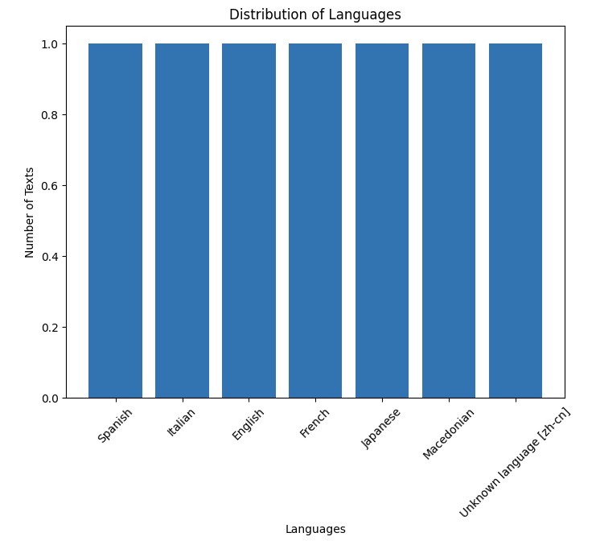
RESULTS
3/21/2024 Annual Review

